Slide 1




PHONE DIRECTORY APPLICATION
USING DOUBLY LINKED LIST & WIN32 GUI (C++)
DEVELOPED IN C++
DATA STRUCTURE BASED PROJECT
GUI-BASED CONTACT MANAGEMENT SYSTEM
Course: Data Structures / Programming

Slide 2




GROUP MEMBER
FAtiha tahir
Malaika arooj
Eman tariq
Alishba arshad

Slide 3

INTRODUCTION
A Phone Directory application manages contacts efficiently
Supports adding, searching, displaying, and deleting contacts
Uses Doubly Linked List for dynamic data handling
Provides a Windows GUI for user-friendly interaction

Slide 4

WHY DOUBLY LINKED LIST?
Each node has:
Previous pointer
Next pointer
Advantages:
Easy insertion & deletion
Bi-directional traversal
Efficient memory usage compared to arrays
Suitable for contact management systems

Slide 5

DATA STRUCTURE DESIGN
Contact Structure:
Name (wstring)
Phone Number (wstring)
Pointer to previous contact
Pointer to next contact
Key Functions:
createContact()
addContact()
searchContacts()
deleteContact()
displayContacts()

Slide 6
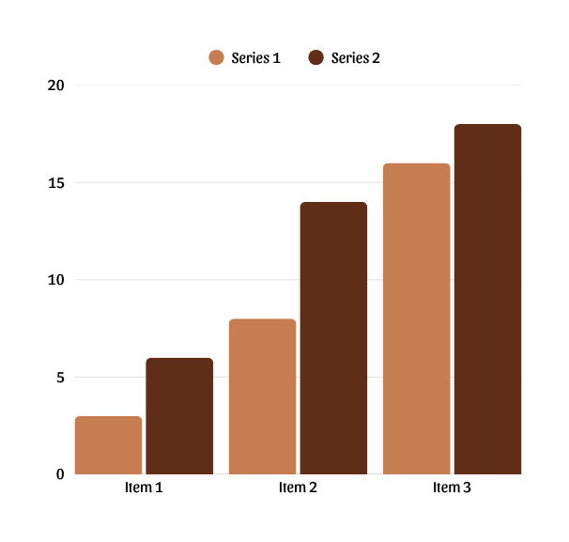
APPLICATION FEATURES
➕ Add new contact
📄 Display all contacts
🔍 Search contacts using name prefix
❌ Delete contact by name
🪟 Result window for search & delete operations
🖥 Simple and interactive GUI

Slide 7
BUILT USING
WIN32 WINDOWS API
GUI DESIGN (WIN32 API)
CONTROLS USED:
STATIC LABELS
EDIT BOXES
BUTTONS
BUTTONS:
ADD
DISPLAY
SEARCH
DELETE
EXIT
SEPARATE RESULT WINDOW FOR OUTPUT DISPLAY

Slide 8
WORKING FLOW
USER ENTERS NAME AND PHONE NUMBER
CLICKS DESIRED ACTION BUTTON
DATA STORED IN DOUBLY LINKED LIST
SEARCH SHOWS LIVE PREFIX-BASED SUGGESTIONS
DELETE UPDATES LINKS DYNAMICALLY
OUTPUT SHOWN USING MESSAGEBOX OR RESULT WINDOW

Slide 9

CONCLUSION
Demonstrates real-life use of data structures
Strong understanding of linked lists & GUI programming
Efficient and user-friendly system

Slide 10
FUTURE ENHANCEMENTS:
File handling for data persistence
Sorting contacts alphabetically
Auto-suggestions while typing
Improved UI design

Slide 11
THANK YOU

